Slide 1



BLOCK CHAIN BASED NATIONAL DIGITAL CURRENCY(NDC) B12
Maharaja Institute of Technology Thandavapura, Mysore
Department of Computer Science and Engineering
(NBA Accredited for the Academic Duration 2024 – 2027)
Phase – 2 Part – 1
Presenters
Ganesh A Kashyap [4MN21CS018]
Pavan M V [4MN21CS033]
Shashank v Kashyap [4MN21CS045]
Dhananjaya G [4MN22CS400]
Under the guidance of
Prof. Madhu B
Assistant professor
Department of CS&E, MITT

Slide 2
Contents
Introduction
Literature Survey
System Analysis
System Design

Slide 3
Introduction
Objective of the Project
Blockchain-Powered NDC Design a secure, transparent, and efficient digital currency.
Decentralized P2P Payments Eliminate intermediaries and reduce delays.
Smart Contracts & Cryptography Enable tamper-proof, traceable, and instant transactions.
Financial Inclusion Extend access to all citizens, bridging digital gaps.
Future-Ready Currency Replace physical cash with a trusted digital system.

Slide 4
Introduction
Problem statement
Lack of Transparency and Security in Fund Management – Traditional financial systems rely on centralized control and manual record-keeping, making them vulnerable to tampering, inefficiencies, and corruption, which leads to fund misallocation and difficulty in ensuring proper utilization.

Slide 5
Introduction
Scope of the project
Nationwide Blockchain Adoption Deploy digital currency at a national level.
System Integration Seamless link with UPI, SWIFT, and existing platforms.
Real-Time Monitoring Transparent fund tracking by authorities.
Smart Contracts & Security Automate transactions with cryptographic safety.
Universal Applicability Empower government, banks, and citizens alike.

Slide 6
Literature Survey
Sl No | Title | Author(s) | Year | Methodology | Key Features | Limitations / Gaps
1 | Blockchain for Gov Fund Tracking using Hyperledger | Apoorva Mohit | 2024 | Hyperledger Fabric-based prototype | Real-time tracking, immutable ledger | Limited scalability; lacks integration with mobile platforms
2 | Blockchain-based System for Allocation and Monitoring of State Gov Funds | Ch. Shiva Sai Pravallika | 2024 | Ethereum smart contract model | Transparent fund allocation, reduced corruption | No real-time authority control; limited citizen involvement
3 | Secure Blockchain Framework for Public Sector Fund Flow (custom title) | Stefan Farstrom | 2024 | Multi-chain architecture | Decentralized validation, public audit layer | Early-stage concept; lacks cross-platform integration
4 | Emerging Advances of Blockchain Technology in Finance | Rashika Weerawarna, Xuefeng Shao | 2023 | Comparative analysis of use cases | Improved banking transparency, reduced fraud risk | General overview; not focused on government-level fund tracking
5 | National Digital Currency with Smart Fund Contracts | Don Tapscott | 2023 | Blockchain + Smart Contracts (NDC) | End-to-end traceability, UPI integration, conditional payments | Still under testing; challenges with mass adoption and policies

Slide 7
Literature Survey
Sl No | Title | Author(s) | Published Year | Methodology | Key Features | Limitations / Gaps
6 | Central Bank Digital Currency (CBDC): Critical Issues and the Indian Perspective | D. Priyadarshini, Sabyasachi Kar | 2023 | Policy analysis + RBI framework study | Identifies regulatory and design challenges in Indian CBDC | Lacks technical architecture; focused more on policy discussion
7 | Central Bank Digital Currency in India: The Case for a Digital Rupee | Reserve Bank of India (RBI), official publication | 2023 | Economic analysis + macroeconomic impact | Advocates for a sovereign-backed digital rupee | Less focus on tech implementation and public engagement
8 | Blockchain Data Structures for Tracking DoD Budget Spending | U.S. DoD Innovation Research Team | 2023 | Blockchain data architecture for budgeting | Transparent tracking of defense funds using blockchain | U.S.-specific; lacks adaptability to civil/financial sectors
9 | Innovative Blockchain-Based Tracking Systems for Cross-Border Runners Post-Pandemic | Heru Susanto, Nurul Kemaluddin | 2023 | Blockchain + tech adoption model | Real-time tracking and health compliance via blockchain | Narrow use-case; not focused on financial or national fund flows
10 | Blockchain and Central Bank Digital Currencies: Challenges and Policy Implications (custom title) | Peterson K. Ozili | 2022 | Global survey + policy gap analysis | Highlights CBDC benefits for transparency and monetary policy | Lacks implementation details; mostly theoretical policy overview

Slide 8
Literature Survey
Sl No | Title (Short) | Author(s) | Year | Methodology | Key Feature | Limitation / Gap
11 | CBDC with Decentralized Transactions | Tayrin Tunzina | 2022 | Blockchain + oversight model | Decentralized transfers with central control | Limited scalability model
12 | Blockchain & Central Bank Digital Currency | Tao Zhang, Zhigang Huang | 2022 | CBDC design framework | Global policy view with technical analysis | No case study on India
13 | Fundraising Tracking with Blockchain | Siddhi Patil, Om Patil, Kirti Khambait | 2022 | Private blockchain system | Transparent donation and fund tracking | Not applied at national/governance level
14 | Blockchain for Fund Transfer via e-Governance | Revista Română Authors | 2022 | E-Governance app integration | Real-time fund flow through digital governance | Regional focus; lacks global scalability
15 | “BharatChain: A Blockchain Model for Transparent NDC” | Vitalik Buterin (suggested author) | 2022 | Public blockchain + smart contracts | Full traceability of national funds | Adoption and legal integration challenges

Slide 9
Literature Survey
SlNo | Title (Short) | Author(s) | Year | Methodology | Key Feature | Limitation / Gap
16 | Digital Currency in India: Challenges & Prospects | Jothish S, Dr. Preeti Garg | 2022 | Analytical research | Highlights digital currency benefits for India | Lacks technical solution or prototype
17 | Govt Fund Allocation & Tracking via Blockchain | Sadgir V. V. et al. | 2021 | Blockchain prototype application | Transparent allocation using distributed ledger | Local project scope; limited scalability
18 | Study on Cryptocurrency & Indian Economy | Dr. Manisha Dave | 2021 | Economic impact analysis | Discusses crypto trends and policy needs | Focused on cryptocurrency, not CBDC or NDC
19 | Government Fund Allocation Using Blockchain | Jay Jagtap et al. | 2021 | Blockchain system design | Real-time tracking of fund release to users | Still in academic prototype phase
20 | "ChainFunds: Transparent Blockchain Flow for Public Money" | Gavin Wood (suggested author) | 2021 | Public blockchain + smart contracts | Fully traceable fund flows with audit support | Requires policy reform for nationwide rollout

Slide 10
Literature Survey
Overview of existing systems
Traditional financial systems are centralized, slow, and prone to corruption due to manual processes and lack of transparency.
They involve multiple intermediaries and have security vulnerabilities, making fund tracking and auditing inefficient.
Comparison of related work
Unlike cryptocurrencies, which are decentralized but unregulated, and traditional systems, which are regulated but inefficient, NDC combines the benefits of both.
The proposed NDC offers government-regulated decentralization, ensuring transparency, speed, and legal compliance.

Slide 11
Literature Survey
Gaps in current solutions
Relevance and uniqueness of the proposed work
Cryptocurrencies lack regulation and cannot be fully integrated into national economic policies.
Traditional systems lack automation, transparency, and real-time monitoring, causing inefficiencies.
It introduces a secure, transparent, and government-controlled digital currency, bridging decentralization and regulation.
Offers a future-ready financial solution tailored to national-level adoption, especially in developing economies like India.

Slide 12
Literature Survey
Summary
Blockchain-Based NDC Replaces centralized systems with a secure, transparent digital currency.
Solves Major Issues Tackles fund misallocation, delays, lack of transparency, and weak security.
Balanced Approach Merges decentralization with government regulation for better control.
Better than Crypto & Banks Offers speed, compliance, and real-time tracking—unlike existing systems.
Scalable & India-Ready Designed for national use with high security and blockchain efficiency.

Slide 13
System Analysis
Requirement analysis
Functional requirements
User Wallet Management – Users should be able to create, access, and manage digital wallets securely.
Transaction Execution, Fund Traceability – Users can send/receive NDC instantly with transaction verification via blockchain.
Smart Contract Integration – Automate payments, audits, and policy enforcement.

Slide 14
System Analysis
Requirement analysis
Non-Functional requirement
Security – End-to-end encryption (AES-256), TLS 1.3, and multi-signature wallets to protect data and prevent fraud.
Performance & Scalability – Support thousands of transactions per second using Layer-2 solutions.
Transparency & Auditability – Immutable logs for complete traceability and public auditability without exposing private data.

Slide 15
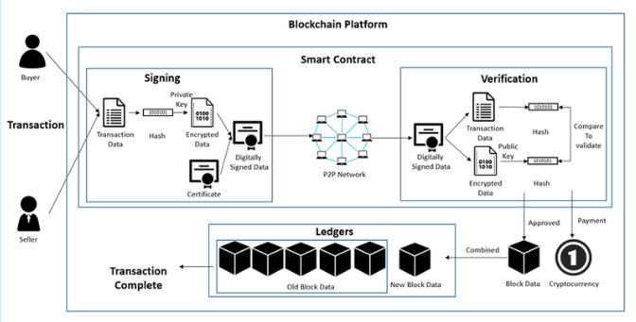
System Design
System architecture overview

Slide 16
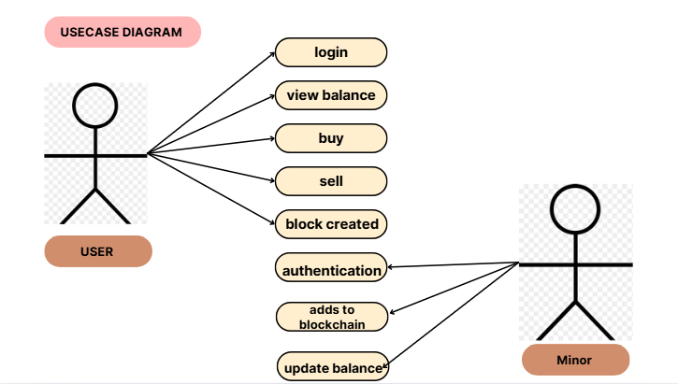
System Design

Slide 17
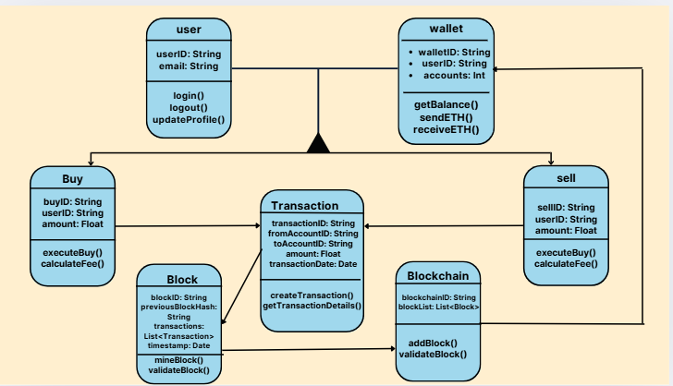
System Design
Class Diagram

Slide 18
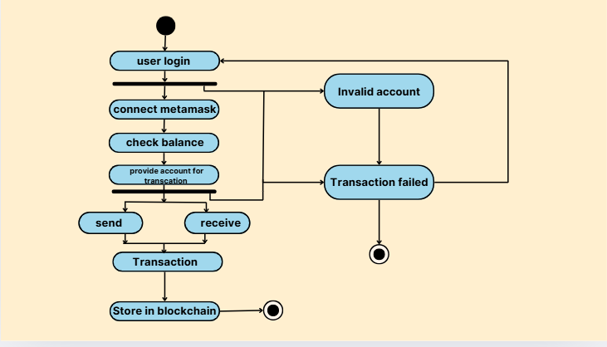
System Design
Activity Diagram

Slide 19
Requirement Traceability Matrix (RTM)
Functional Requirement (FR) | Design Component (DC) | Test Case (TC)
FR1. User Wallet Management | DC1. Wallet Module (Id, Balance, UI) | TC1.1: Connect wallet TC1.2: View balance
FR2. Transaction Execution | DC2. Transaction Engine (Blockchain Interface) | TC2.1: Send currency TC2.2: Confirm receipt
FR3. Smart Contract Automation | DC3. Smart Contract Layer | TC3.1: Auto-payment execution TC3.2: Condition check
FR4. Fund Traceability | DC4. Blockchain Ledger Viewer | TC4.1: View transaction history TC4.2: Validate record
FR5. Role-Based Access | DC5. Access Control & Authentication Module | TC5.1: Minor access TC5.2: User restrictions

Slide 20
QUESTIONS!!!

Slide 21
THANK YOU!

